Slide 1
Chapter 1
Textbook questions

Slide 2
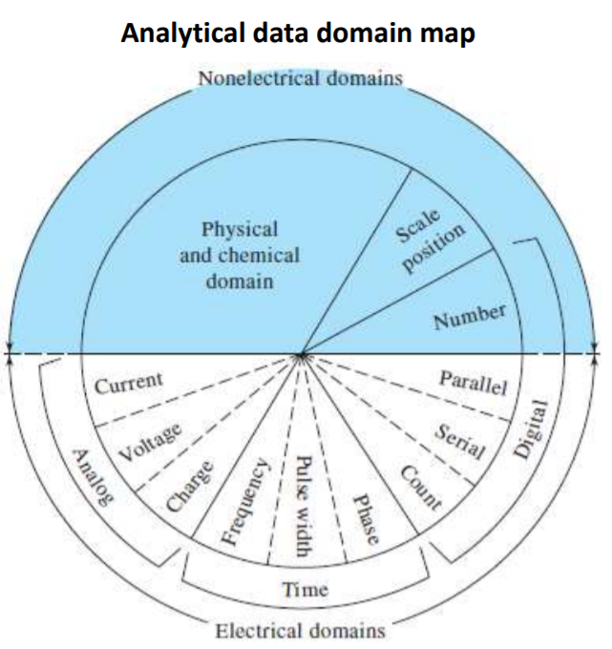
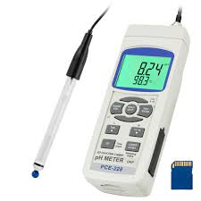
Question 1-1
What is a transducer in an analytical instrument?
換能器是一種將化學或物理信息互相轉換成電信號的設備。
https://www.google.com/search?q=pH+meter&tbm=isch&ved=2ahUKEwil1fViZLoAhVTxIsBHSq2AFwQ2cCegQIABAA&oq=pH+meter&gs_l=img.3..0l7j0i30l3.194688.198220..198744...1.0..0.102.468.7j1......0....1..gwswizimg.....10..35i362i39j35i39.SV24PCPh3c&ei=96poXuX_CdOIr7wPquyC4AU&bih=748&biw=1707&rlz=1C1GCEA_enTW850TW850#imgrc=jW-pD6-loEAqhM
Skoog D.A., Holler F.J., Crouch S.R. 2017, Principles of Instrumental Analysis, 7th Edition. Cengage.

Slide 3
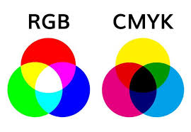
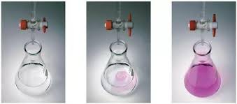
Question 1-2
What is the information processor in an instrument for measuring the colour of a solution visually?
視覺色彩測量系統中的信息處理器是人的頭腦。
https://www.google.com/search?q=RGB&tbm=isch&ved=2ahUKEwin9om1ipLoAhUGdJQKHRAhBaoQ2cCegQIABAA&oq=RGB&gs_l=img.3..0l10.1100950.1102203..1103282...1.0..0.43.122.3......0....1..gwswizimg.....10..35i362i39.QzCXpeZM9Rs&ei=vqtoXqefOobo0QSQwpTQCg&bih=748&biw=1707&rlz=1C1GCEA_enTW850TW850#imgrc=VNgqUSXVSNMSjM
https://www.google.com/search?q=%E6%BB%B4%E5%AE%9A&tbm=isch&ved=2ahUKEwi7pOzLkJLoAhWVAKYKHS3UAYQ2cCegQIABAA&oq=%E6%BB%B4%E5%AE%9A&gs_l=img.3..0l10.167700.170799..171620...1.0..0.50.368.9......0....1..gwswizimg.....10..35i39j35i362i39.FokjuVdqELk&ei=ObJoXvujE5WBmAWtqIwDg&bih=748&biw=1707&rlz=1C1GCEA_enTW850TW850#imgrc=Onj3FUmmENSVHM

Slide 4
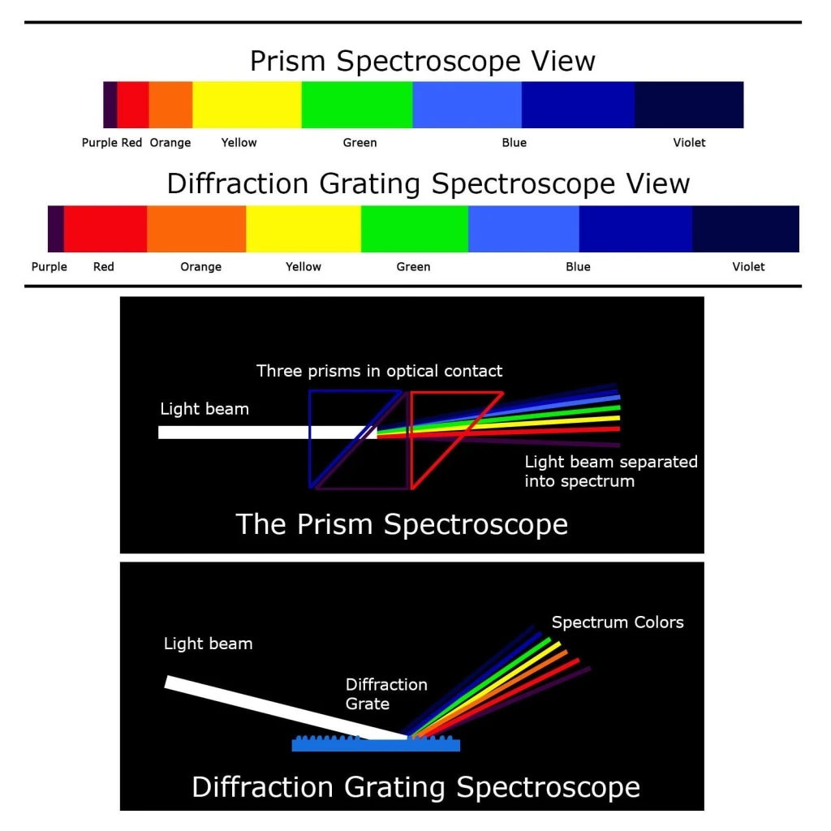
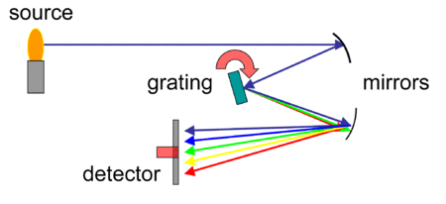
Question 1-3
What is the detector in a spectrograph in which spectral lines are recorded photographically?
光譜儀中的檢測器是攝影膠片或板。
https://zh.wikipedia.org/wiki/%E5%85%89%E8%B0%B1%E4%BB%AA
https://www.google.com/search?q=Spectroscope&tbm=isch&ved=2ahUKEwic1I_OupLoAhXNxGEKHVUNCj8Q2cCegQIABAA&oq=Spectroscope&gs_l=img.3..35i39l2j0i30l8.97281.98320..98626...0.0..0.51.267.6......0....1..gwswizimg.......0i19j0i8i30i19.ZlC79oL2sI8&ei=SN5oXpyQF82JhwPVmqj4Aw&bih=748&biw=1707&rlz=1C1GCEA_enTW850TW850&hl=zhTW#imgrc=hiSJ2LGOd0HIMM

Slide 5
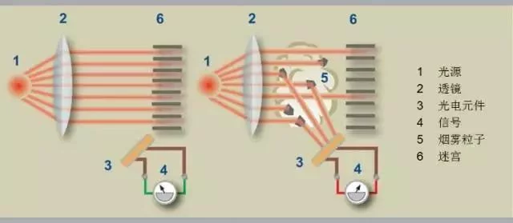
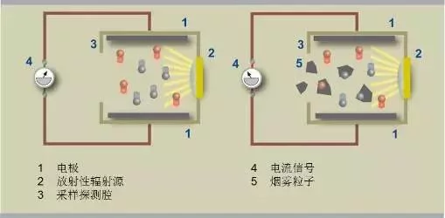
Question 1-4
What is the transducer in a smoke detector?
煙霧探測器有兩種類型：光電探測 (photodetectors) 和電離探測器 (ionization detector)。
光電探測器
電離探測器
https://kknews.cc/zh-tw/science/6l883p.html

Slide 6
Question 1-5
What is a data domain?
數據域，將訊息密碼化的各種方式稱為數據域，是一種包含數據的形式，可將訊息解碼為另ㄧ種訊息，其可分為電性域(electrical domain)和非電性域(nonelectricaldomain)，其方法有電流、電壓、數位數字、長度、密度、光強度等。
Skoog D.A., Holler F.J., Crouch S.R. 2017, Principles of Instrumental Analysis, 7th Edition. Cengage.

Slide 7
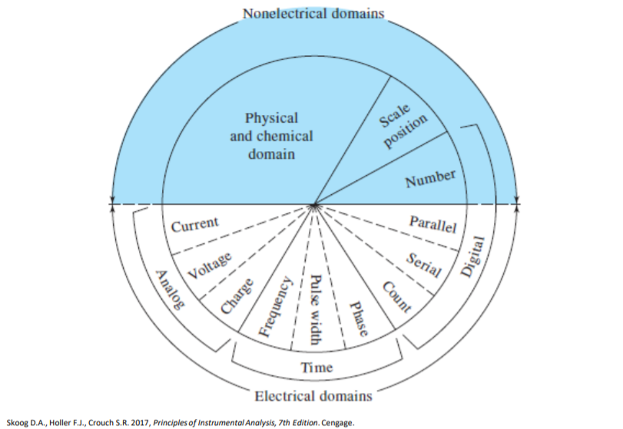
Question 1-6
Name electrical signals that are considered time-domain signals? How is the information encoded in a time-domain signal?
Time-domain signals include period, frequency, and pulse width.
時間域包含週期、頻率、脈衝寬。
The information is encoded in the time relationship of signal fluctuations.
這類訊息以訊號波動對時間來編碼。

Slide 8
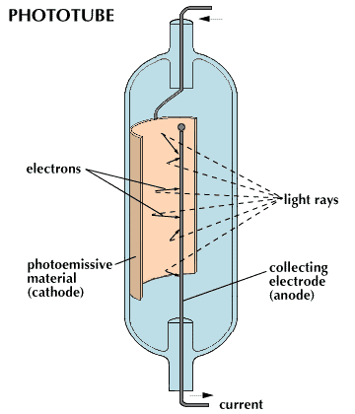
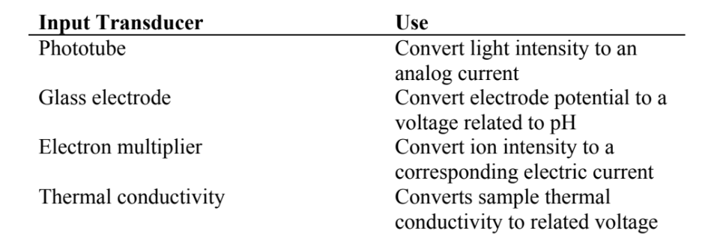
Question 1-7
List four input transducers and describe how they are used?
https://kids.britannica.com/students/assembly/view/53788

Slide 9
Question 1-8
What is a figure of merit?
A figure of merit(品質因數)is a number that provides quantitative information about some performance criterion for an instrument or method.
品質因數是用於表示儀器或方法的性能的數量
Example: Resolution of the image sensor in a digital camera
https://en.wikipedia.org/wiki/Figure_of_merit

Slide 10
Question 1-9
A 25.0mL sample containing Cu²⁺ gave an instrument signal of 25.2 units (corrected for a blank). When exactly 0.500mL of 0.0275 M Cu(NO₃)₂ was added to the solution, the signal increased to 45.1 units. Calculate the molar concentration of Cu²⁺ assuming that the signal was directly proportional to the analyte concentration?
6.66×10⁻⁴ M

Slide 11
